Slide 1



Machine learning
What it is, how it works, and why we use it

Slide 2

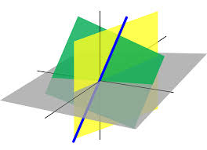
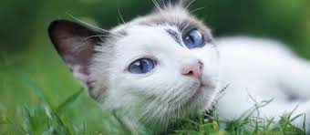
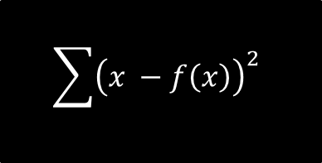
What is machine learning?
$$\sum{{\left(x −f\left(x\right)\right)}^{2}}$$
DATA
FANCY MATH
MAKE A PREDICTION!
Cat!

Slide 3
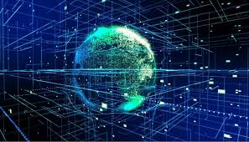
Why we use machine learning
Find patterns humans can’t and don’t notice
Big data
Computer vision
Natural Language processing
(NLP)

Slide 4
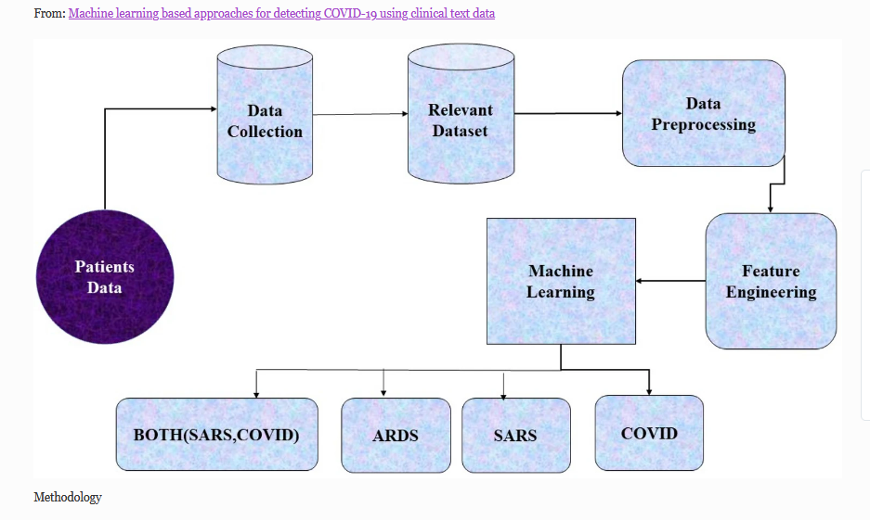
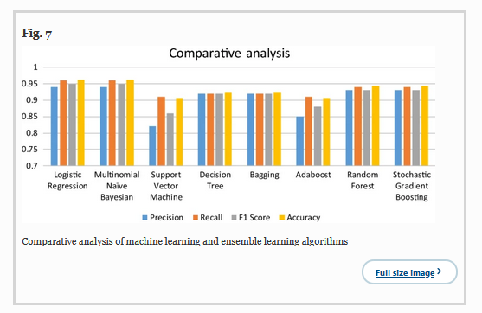
Covid and ML
Research:
Machine learning based approaches for detecting COVID-19 using clinical text data
Akib Mohi Ud Din Khanday,
Syed Tanzeel Rabani,
Qamar Rayees Khan,
Nusrat Rouf &
Masarat Mohi Ud Din

Slide 5
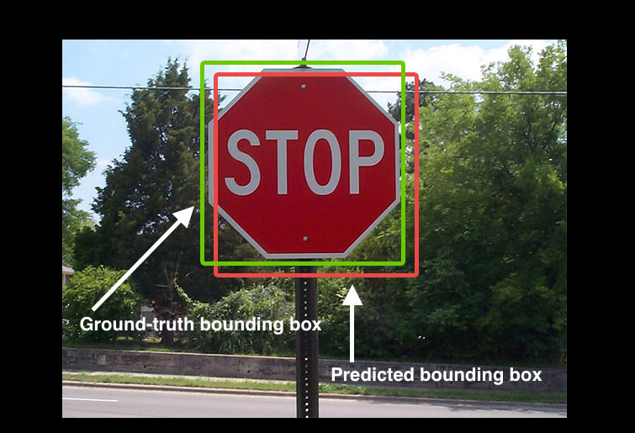
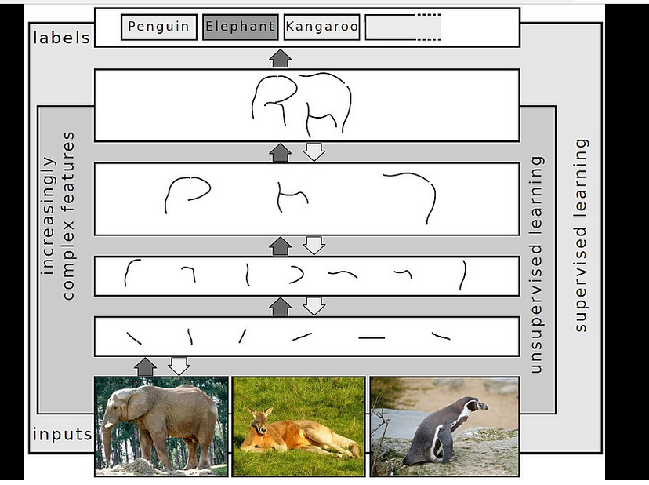
Computer Vision
Helping computers see

Slide 6
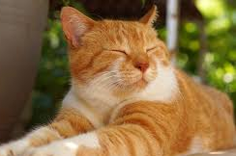
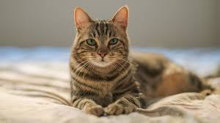
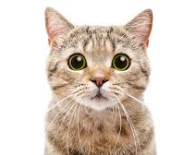
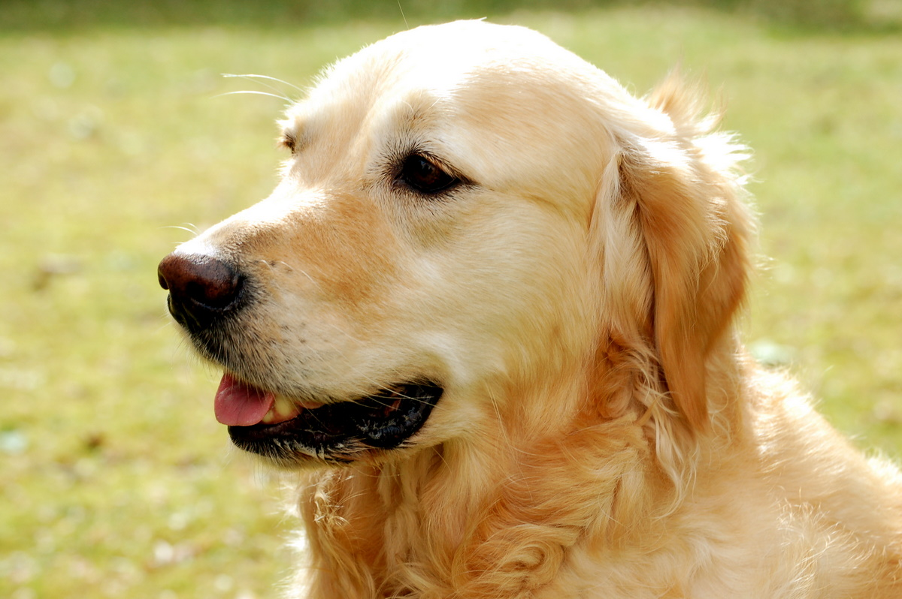
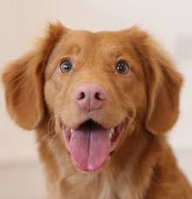
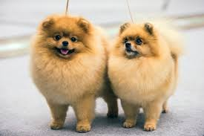
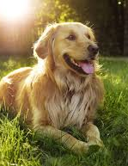
How we use machine learning
Labeled Data:
Cats & Dogs
Train the model
Test the model
Dog
The model says I’m a dog
teachablemachine.withgoogle.com/models/MhR0yhfrV/
This model actually works!
Click on link!
Cat
This Photo by Unknown Author is licensed under CC BY-SA

Slide 7
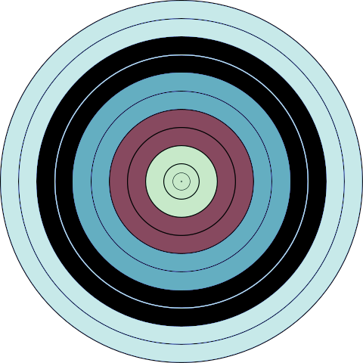
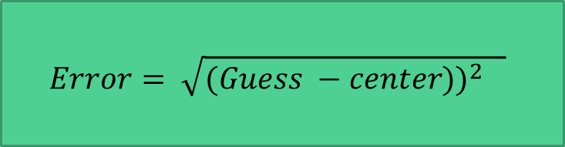
Supervised Machine learning (simplified)
Update guess
(Make a slightly better guess)
(2) Figure out how bad that guess was
$$Error= \sqrt{{(Guess −center))}^{2} }$$
(1) Make a random guess

Slide 8
Supervised Machine learning (simplified)
Initialize your model
(1) Make a random guess

Slide 9
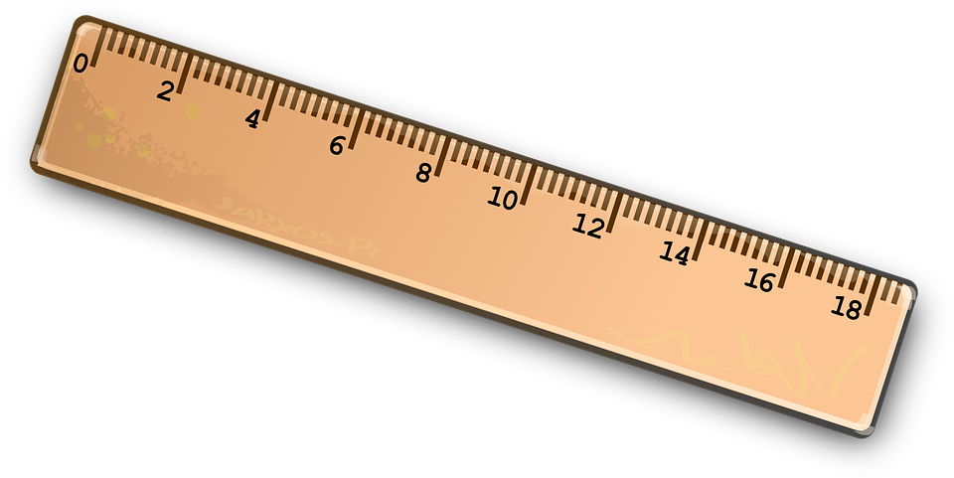
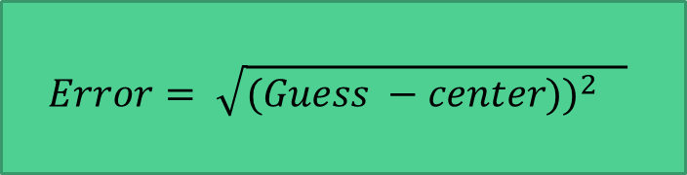
Supervised Machine learning (simplified)
(2) Measure the distance from guess to target
Calculate the error using a cost function
$$Error= \sqrt{{(Guess −center))}^{2} }$$

Slide 10
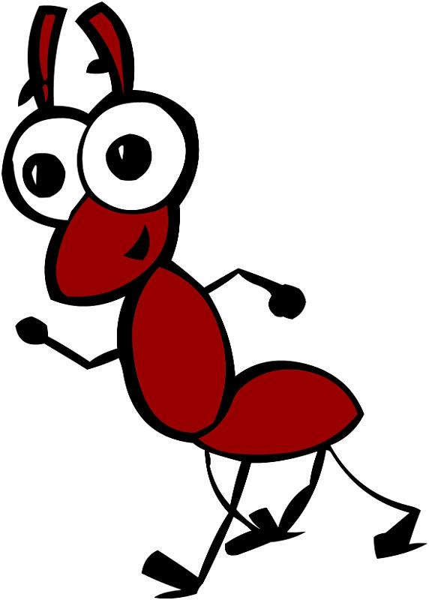
Supervised Machine learning (simplified)
Update guess
Also called the learning rate or step size
Small steps, learning rate must be small

Slide 11
Supervised Machine learning (simplified)
REPEAT lots of times
Until cost is as small as possible
Update guess
Also called the learning rate or step size

Slide 12
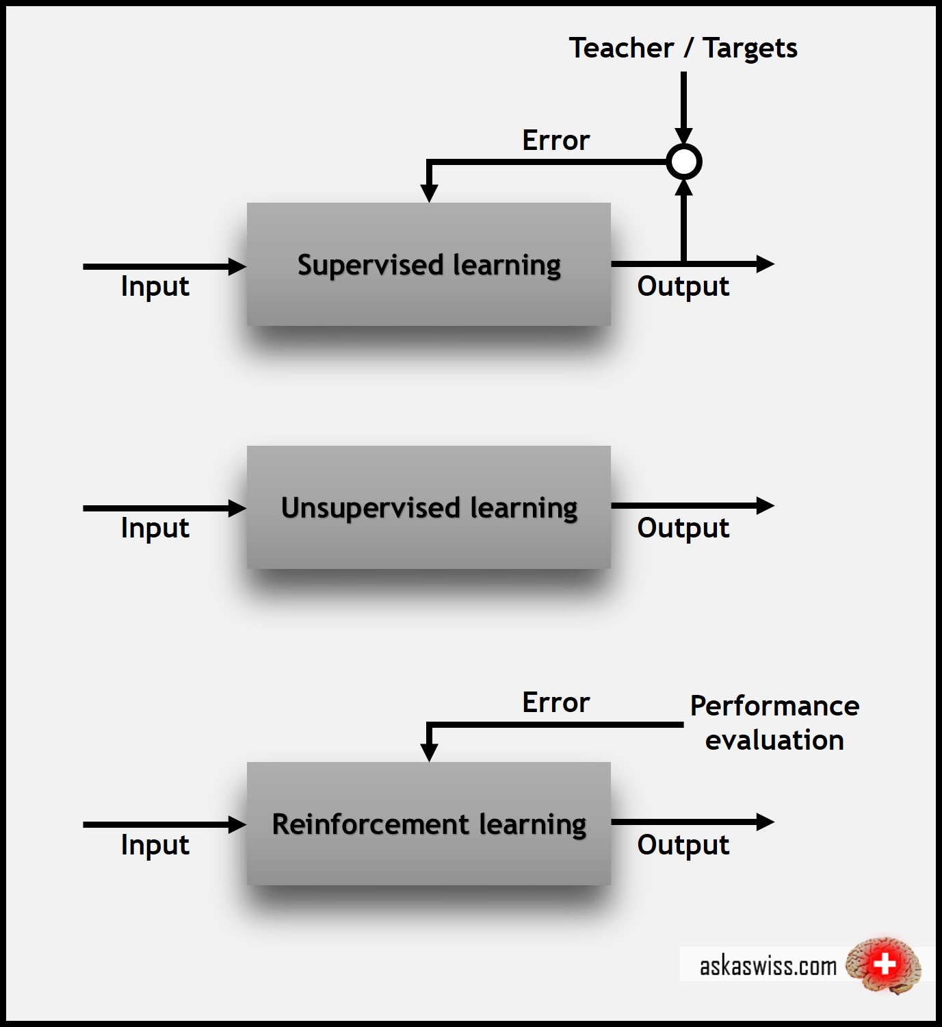
Supervised and unsupervised
Uses labeled data
Finds patterns in the data
Trying to emulate how our brains learn

Slide 13
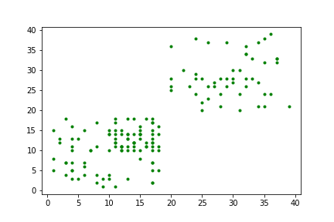
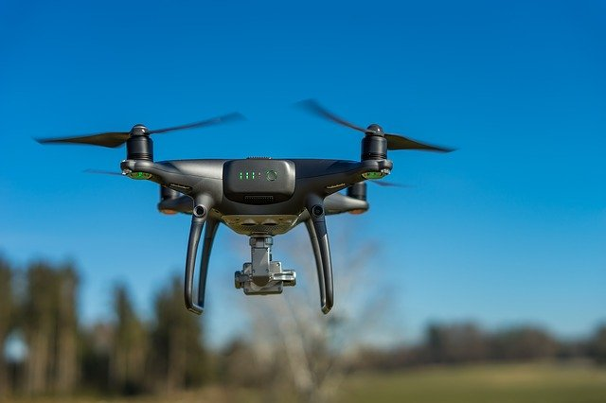
K-means algorithm
Say you are trying to design an algorithm to figure out the best place to deliver a newspaper

Slide 14
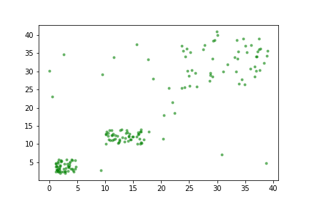
K-means algorithm
Where are the targets most likely located?
How many targets do you think we have?

Slide 15
Our algorithm
Make a guess on number of targets
Initialize random target values
Calculate error
Repeat

Slide 16
Our algorithm
To-do
Decide number of kernels to test
Decide learning rate
Calculate number of repeats

Slide 17
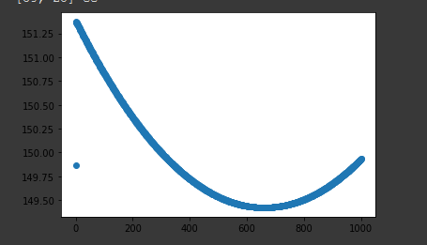
Analysis
Our code will generate these graphs
This is loss versus iteration
Minimum loss

Slide 18
Explore! ML visualizations!
K means Clustering
https://www.naftaliharris.com/blog/visualizing-k-means-clustering/
Another similar algorithm
https://www.naftaliharris.com/blog/visualizing-dbscan-clustering/

Slide 19
Explore!
These next few slides will show you how to run the code environment
You will get to play around with different hyperparameters such as learning rate, iterations, number of centroids.
On a separate piece of paper record your findings!
This model is not the most optimized, what would you do differently in order to create better parameters

Slide 20
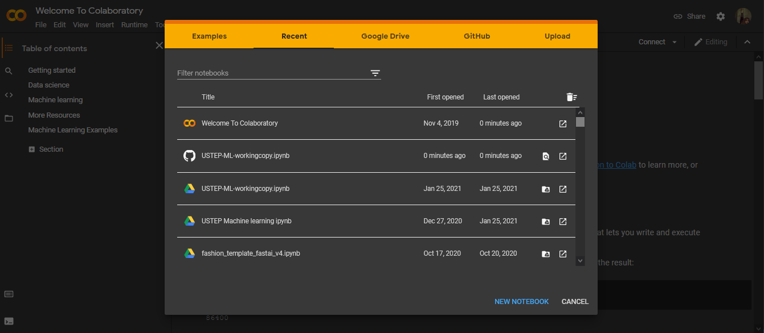
Instructions:
https://colab.research.google.com/

Slide 21
Instructions:
https://colab.research.google.com/
Click here

Slide 22
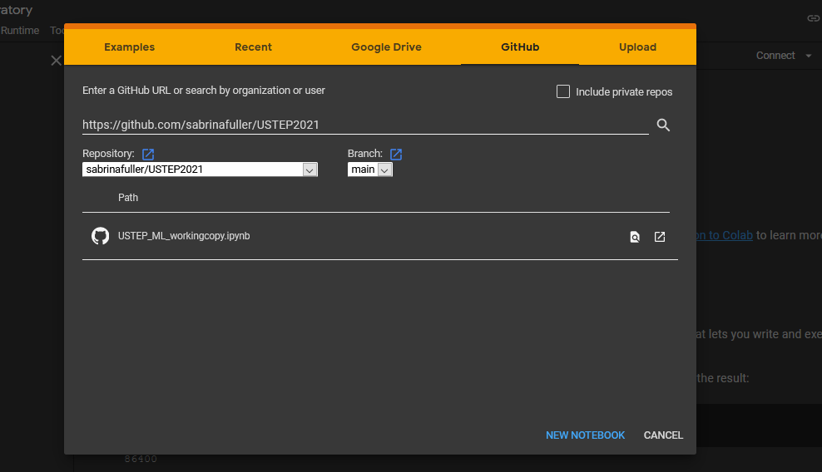
Instructions:
Step (1)
Step (2)
https://github.com/sabrinafuller/USTEP2021
Click here
To make the python notebook
Type in

Slide 23
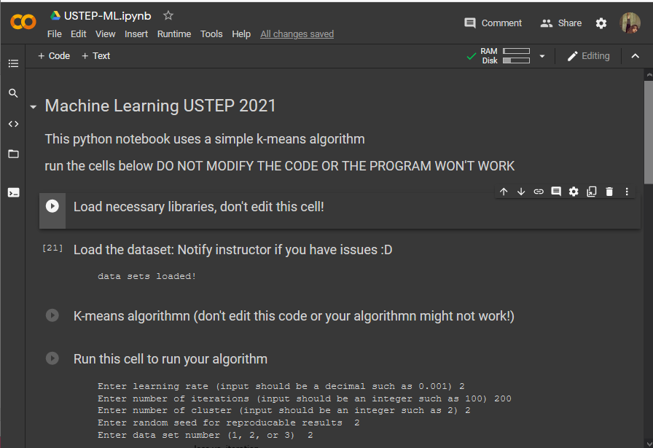
No coding is necessary

Slide 24
Run these cells
Click on the arrow
These load the needed code

Slide 25
Run these cells
Click on the arrow
Click on this run bottom to run your algorithm

Slide 26
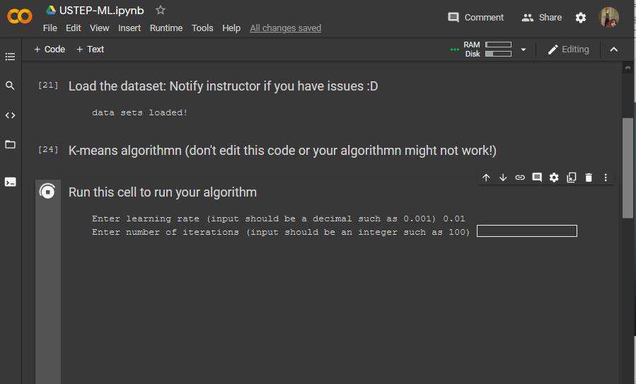
After you run you will be prompted to enter your learning rate etc….

Slide 27

Explore more! Other machine learning models
Another k-means algorithm
https://user.ceng.metu.edu.tr/~akifakkus/courses/ceng574/k-means/
Image model used earlier in the slides
https://experiments.withgoogle.com/collection/ai

